Slide 1
Employee Data Analysis using Excel
STUDENT NAME:L.Deepa
REGISTER NO: 31221490
DEPARTMENT: Bcom (CA)
COLLEGE: Annai Veilankanni’s college for women

Slide 2
PROJECT TITLE
Employee Performance Analysis using Excel

Slide 3


AGENDA
Problem Statement
Project Overview
End Users
Our Solution and Proposition
Dataset Description
Modelling Approach
Results and Discussion
Conclusion
3/21/2024 Annual Review

Slide 4

PROBLEM STATEMENT
The problem should be specific, relevant, and actionable. For example, instead of saying "I want to analyze customer satisfaction", you could say "I want to find out how customer satisfaction affects retention and revenue for our online store".

Slide 5

PROJECT OVERVIEW
Data analytics refers to the use of statistical and quantitative methods to analyze datasets and extract insights that can be applied to project management processes. It involves collecting, organizing, and analyzing these datasets to uncover patterns and trends that can inform business decisions
.

Slide 6

WHO ARE THE END USERS?
Ease of useEnd users should be able to easily use the data analytics without needing technical knowledge. User interfaceThe user interface should be intuitive and mirror the ease of use of the internet. Information deliveryIt's important to understand what information the end users need and how best to deliver it to them. End user experienceIt's important to consider the end user experience when developing data analytics. End user profileIt's important to build a profile of the end users, including their demographics, needs, goals, and user behaviors.

Slide 7

OUR SOLUTION AND ITS VALUE PROPOSITION
Data analytics can help strengthen a company's value proposition by identifying customer needs, validating assumptions, and demonstrating impact. A value proposition is a statement that explains how a product or service solves a problem, benefits a customer, or fills a need. It's a key part of a company's strategy and can help attract customers and guide their decision-making.

Slide 8
Dataset Description
Data analysis is the process of collecting, cleaning, transforming, modeling, and interpreting data to gain insights and support decision making. Data analysis can include a variety of techniques, such as statistical modeling, exploratory data analysis, and confirmatory data analysis. Data analysis is used in many fields, including business, science, and social science. It can help organizations make informed decisions, predict trends, and improve operational efficiency.

Slide 9

THE "WOW" IN OUR SOLUTION
Diverse perspectivesWomen bring different perspectives and creative thinking to data analysis, which can lead to new insights and outcomes. RepresentationOrganizations that strive for greater diversity and inclusivity see improvements in workplace satisfaction and business profitability. EmpowermentWomen in Data® is an organization that helps drive for more accurate representation in data analysis and gathering. They offer professional networking, knowledge transfer, and initiatives for women's health, safety, and girls in data. ConfidenceWomen in tech face challenges such as being seen as an equal in a predominantly male industry, and cultivating confidence to own their voice and present ideas. Learning from mistakesIt's okay to make mistakes and be wrong, and growth often comes from the lessons learned from those moments.
3/21/2024 Annual Review
9

Slide 10
MODELLING
Data modeling can involve the following steps: Requirements analysis, Conceptual modeling, Logical modeling, Physical modeling, and Maintenance and optimization. Data modeling is different from data analysis, which involves querying databases and analyzing machine learning models.
10

Slide 11
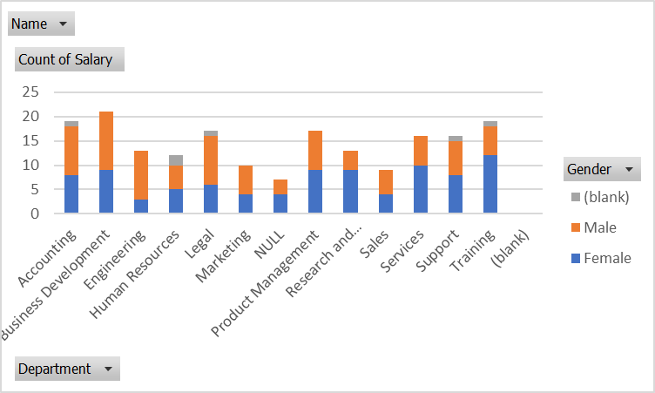
RESULTS
11

Slide 12
conclusion
Address the original question or problem Revisit the purpose of the experiment and hypothesis Evaluate the data Explain the effect of any procedural changes or experimental error Consider variables that could not be controlled for Determine the significance or importance of the data analysis Ensure conclusions are valid and limited to the results of the experiment Reprise the questions and conclusions of the introduction Raise new questions or future work

